Slide 1
A survey to the problem of eXplainable Neural Network (XNN)
2019-11-06

Slide 2

1. Survey interests
Instead of the works to create a new explainable NN architecture,
we are interesting in the works on traditional given DNNs to achieve explanation^{[XNN16], [XNN18].}

Slide 3
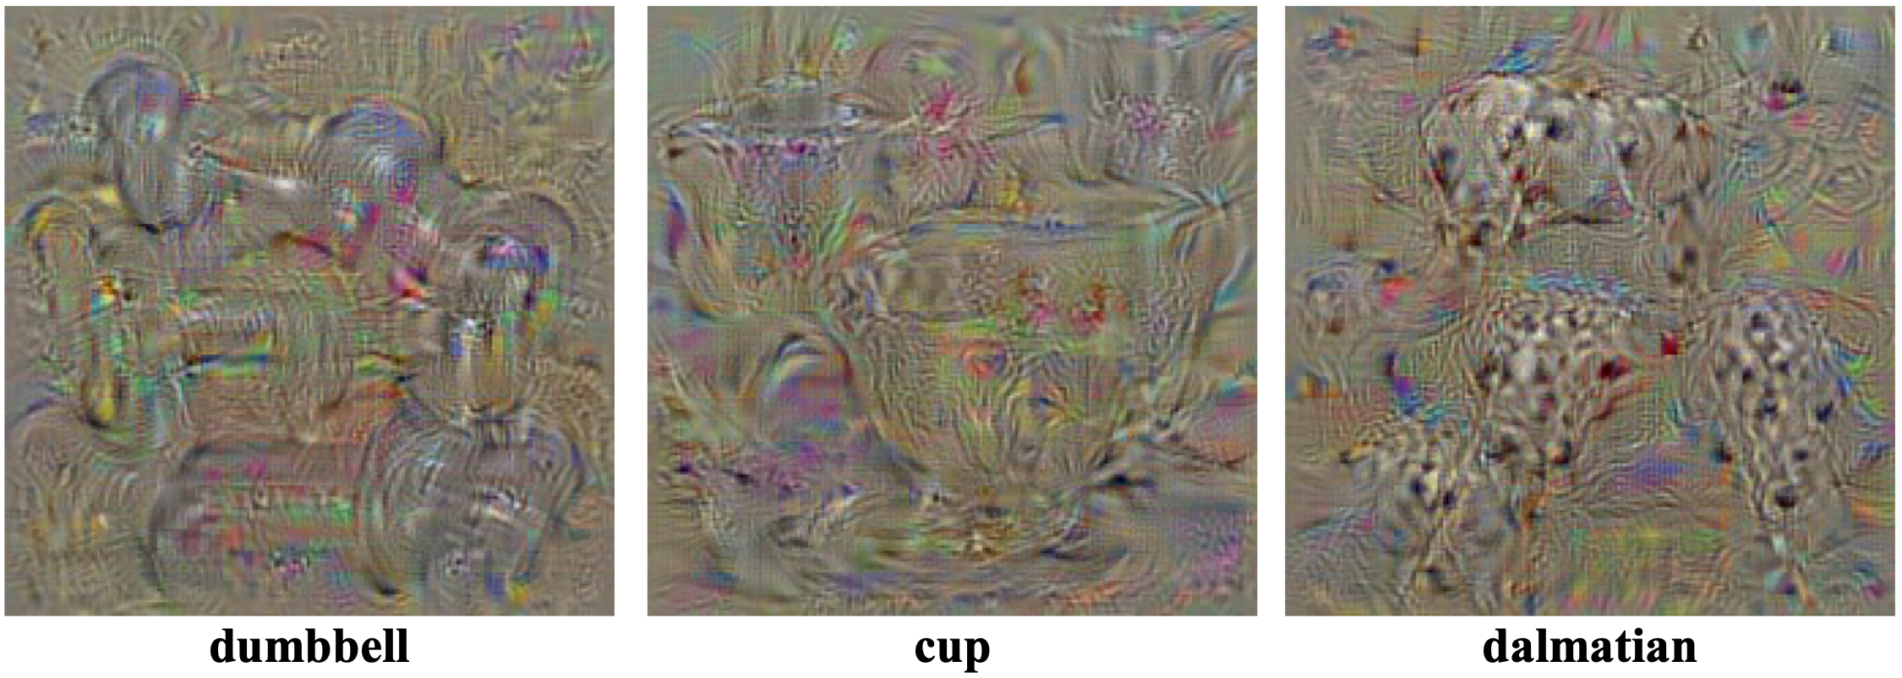
2. What is XNN?
X
Y
(1) Interpretation^{[Montavon18]}
An interpretation is the mapping of an abstract concept (e.g. a predicted class) into a domain that the human can make sense of ^{[DICN13].}

Slide 4
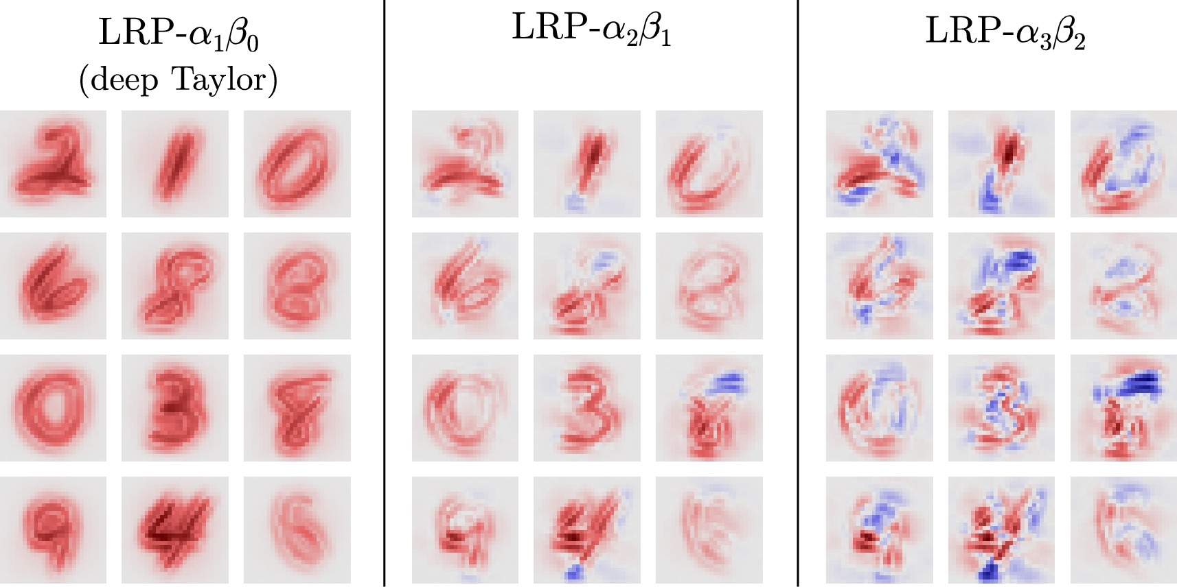
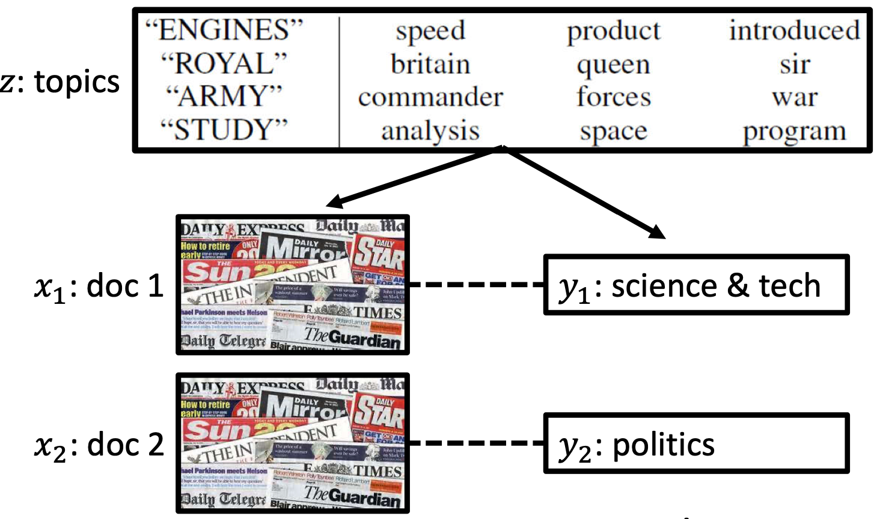
2. What is XNN?
X
Y
(2) Explanation^{[Montavon18]}
An explanation is the collection of features of the interpretable domain, that have contributed for a given example to produce a decision (e.g. classification or regression).
^{[DICN13]}
^{[SLDA10]}

Slide 5
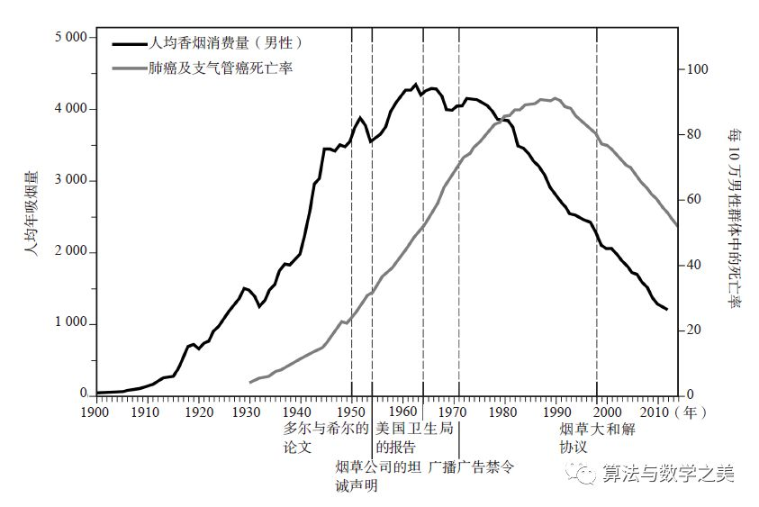
2. What is XNN?
X
Y
(3) Causality^{[SCM95]}
Causality is efficacy, by which one process or state, a cause, contributes to the production of another process or state.
The cause is partly responsible for the effect, and the effect is partly dependent on the cause.

Slide 6
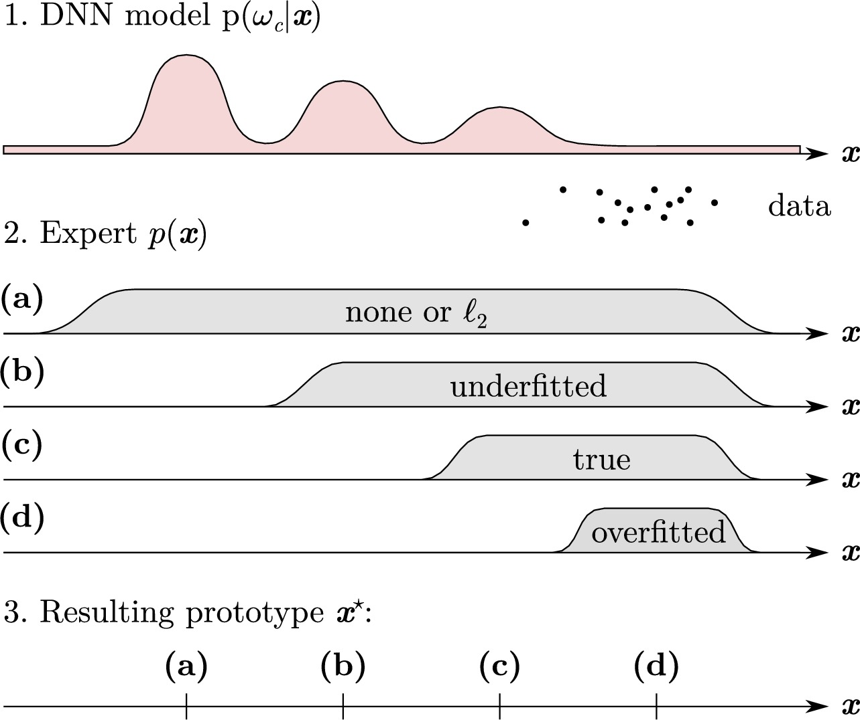
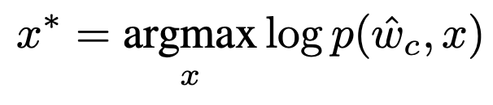
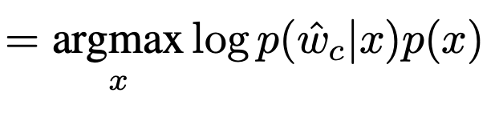
3. Interpretation
X
w_{c}
Activation maximization^{[AM09] [DICN13]}

Slide 7
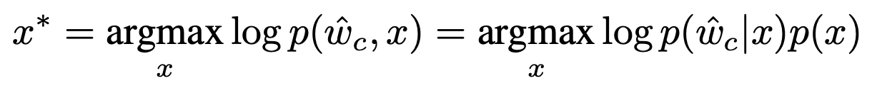
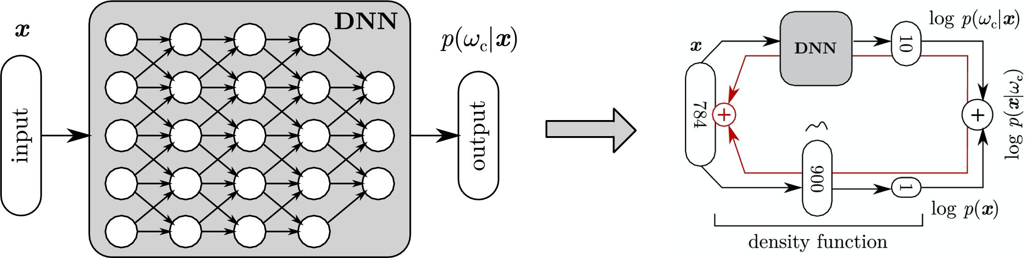
3. Interpretation
X
w_{c}
Activation maximization - DBN^{[CDBN09]}

Slide 8
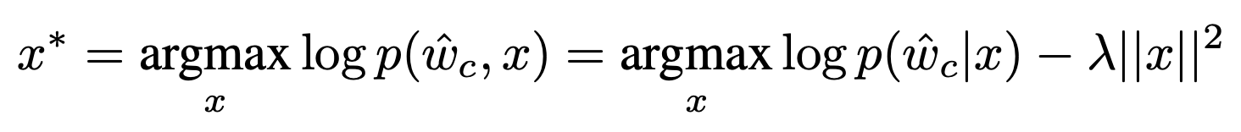
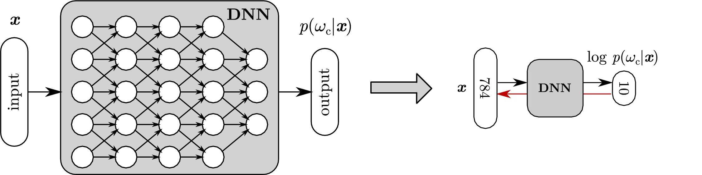
3. Interpretation
X
w_{c}
Activation maximization - Simple^{[AM09]}

Slide 9
3. Interpretation
X
w_{c}
Activation maximization – Simple with reference pnt^{[AMRP16]}

Slide 10
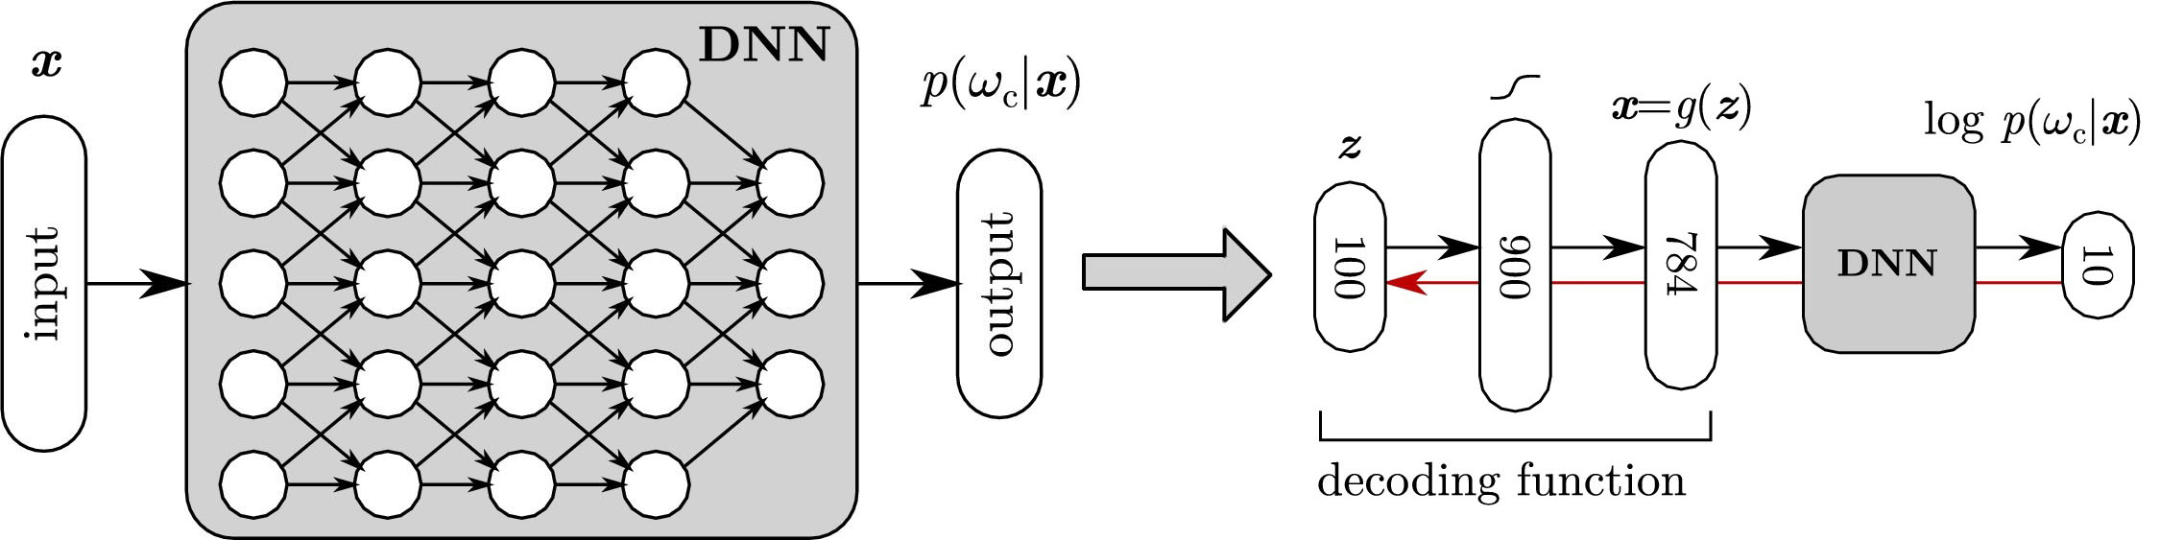
3. Interpretation
Z
w_{c}
Activation maximization in code space - GAN^{[GAN16][AMGAN17]}

Slide 11
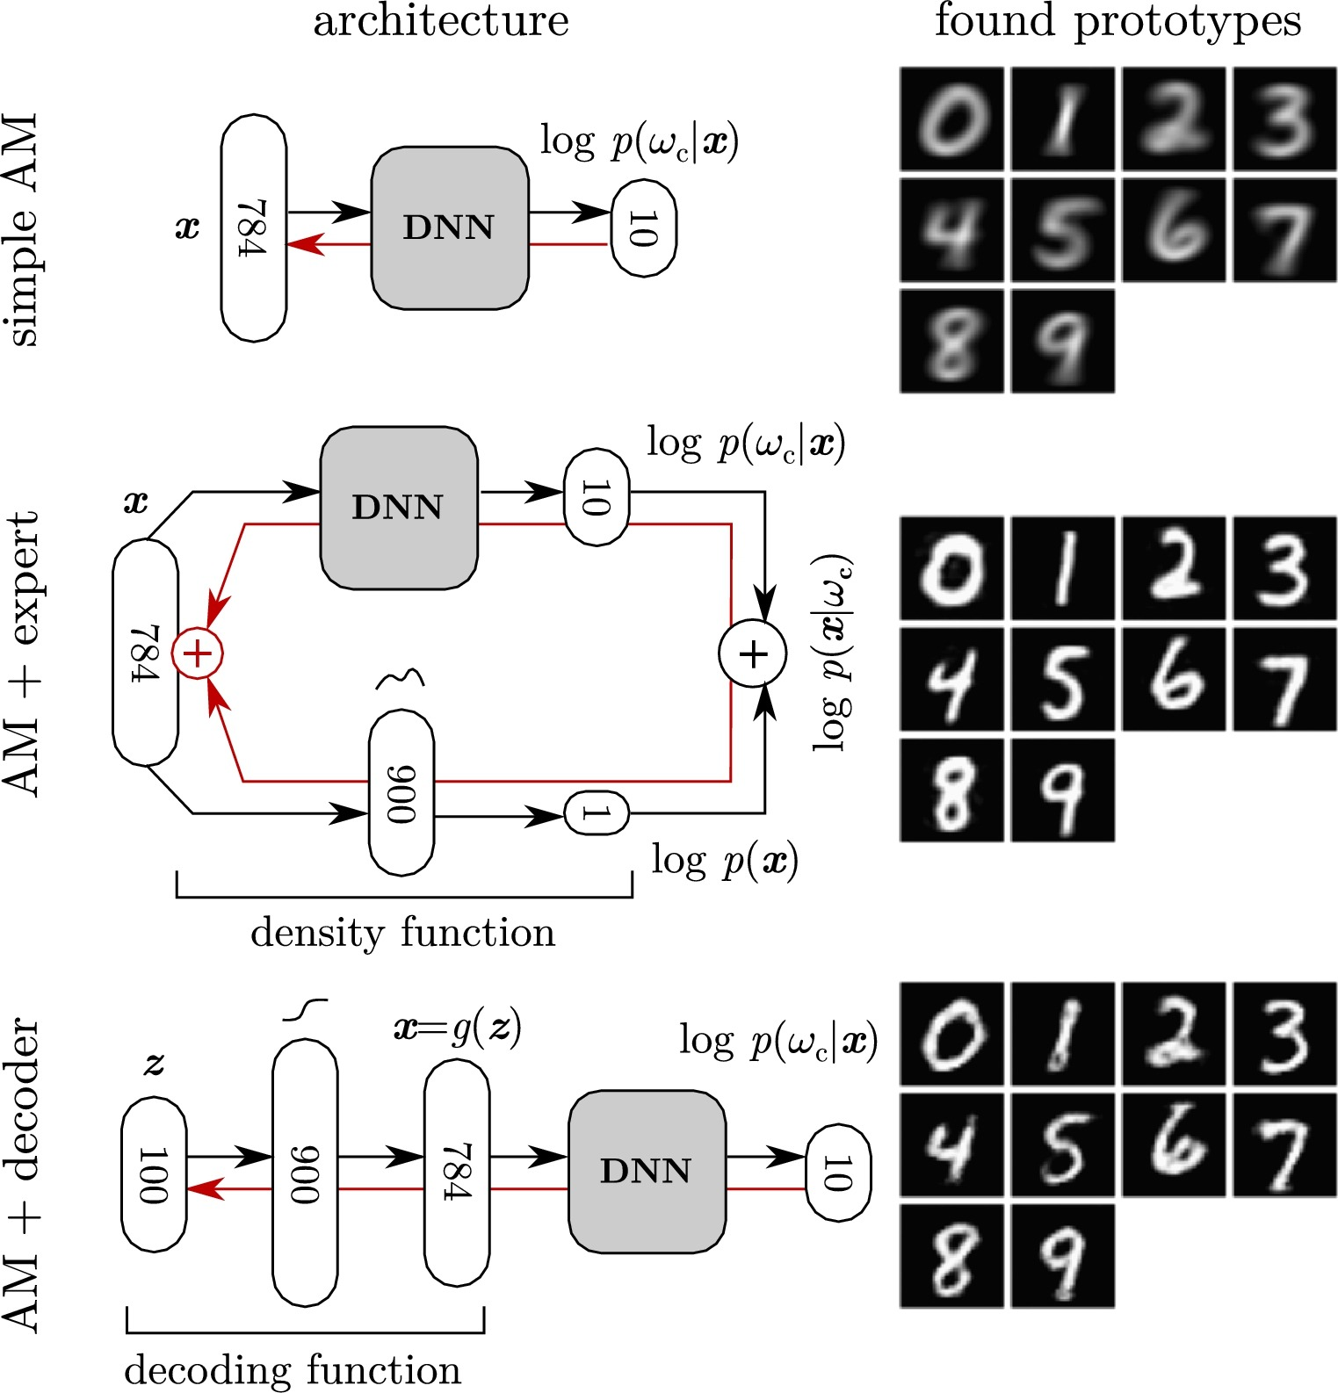
3. Interpretation – Summarize
Z
w_{c}

Slide 12
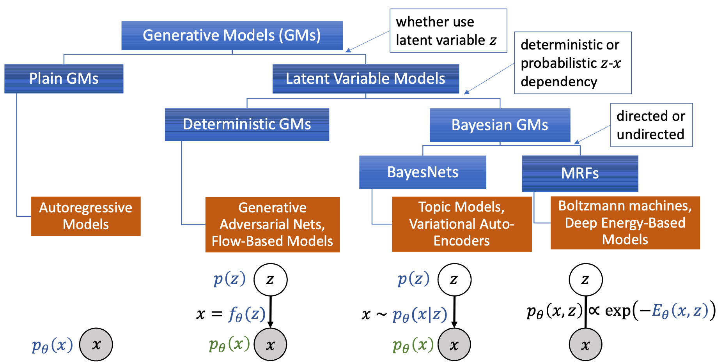
3. Interpretation – GMs
Z
w_{c}

Slide 13
3. Interpretation – TBD
Z
w_{c}
(1) Go down to the codes of AM-GMs, expand to Bayesian net.
(2) Which one is the best scalable solution?
(3) How to achieve the interpretation of code space?
(4) How to expand the interpretation into temporal process?

Slide 14
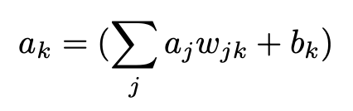
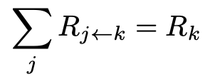
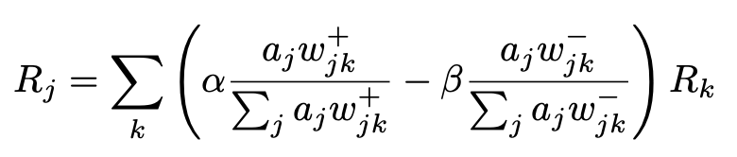
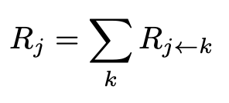
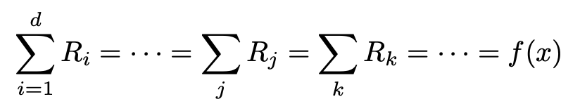
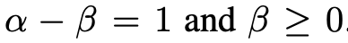
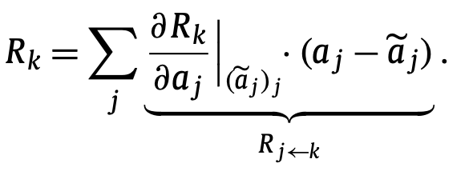
4. Explanation – Sensitivity analysis
x
w_{c}
Layer-wise relevance propagation (LRP)^{[LRP15][Taylor17]}

Slide 15
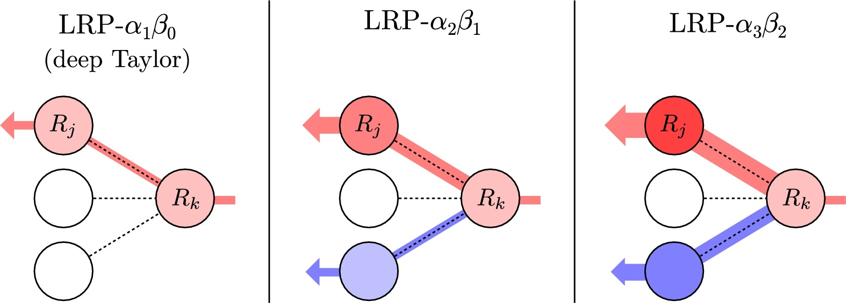
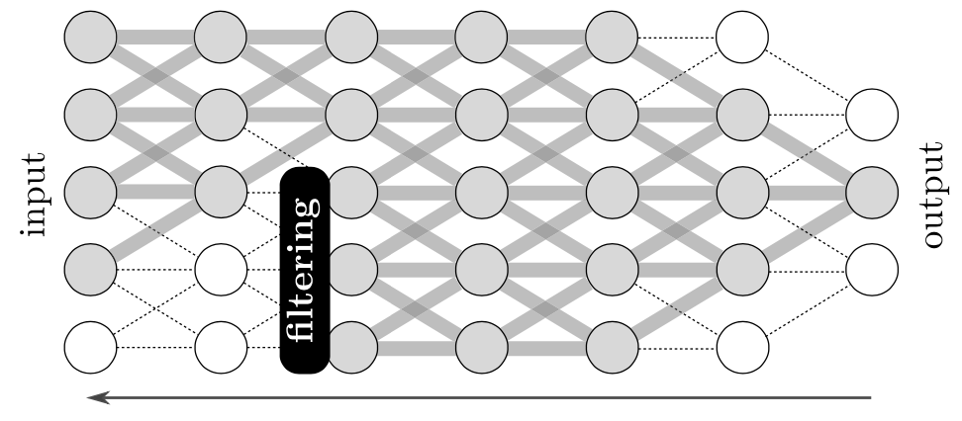
4. Explanation – Sensitivity analysis
x
w_{c}
Layer-wise relevance propagation (LRP)^{[LRP15]}

Slide 16
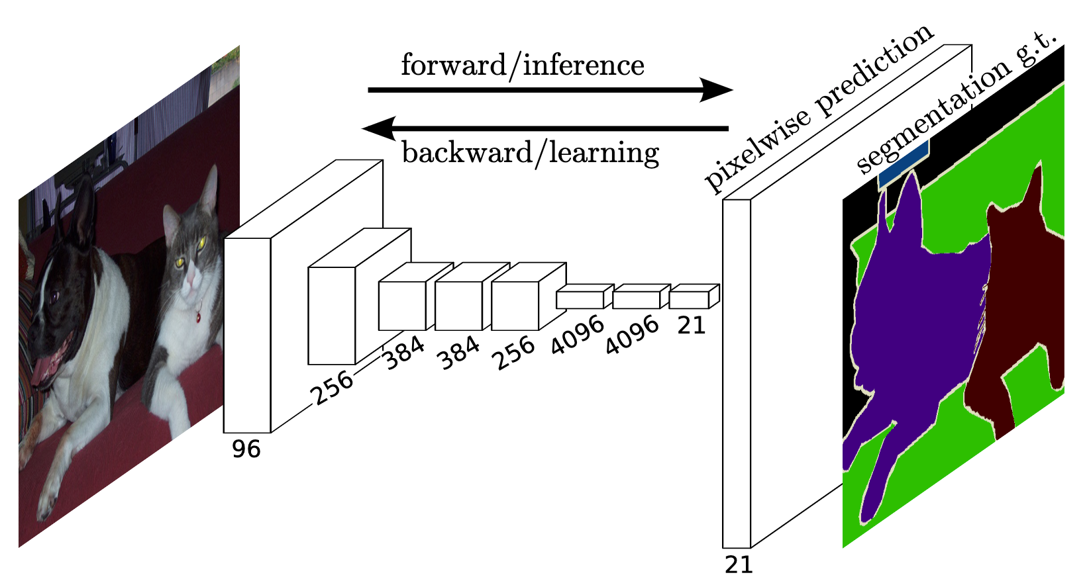
4. Explanation – Deconvolution
x
w_{c}
Fully convolutional network(FCN)^{[FCN16], [AllCNN14]}

Slide 17
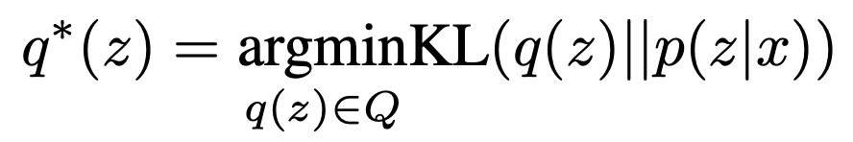
4. Explanation – in code space
Z
w_{c}
Variational inference (VI)^{[VI16] [LDA03] [SLDA10]}

Slide 18
4. Explanation – in code space
Z
w_{c}
Supervised latent Dirichlet allocation(SLDA)^{[SLDA10]}

Slide 19
4. Explanation – TBD
Z
w_{c}
(1) Go down to the codes of FCN16 and SLDA10.
(2) Confirm Bayesian inference expressions of explanation.
(3) Which one is the best scalable solution?
(4) How to expand the explanation into temporal process^{[XNLP15]}?

Slide 20
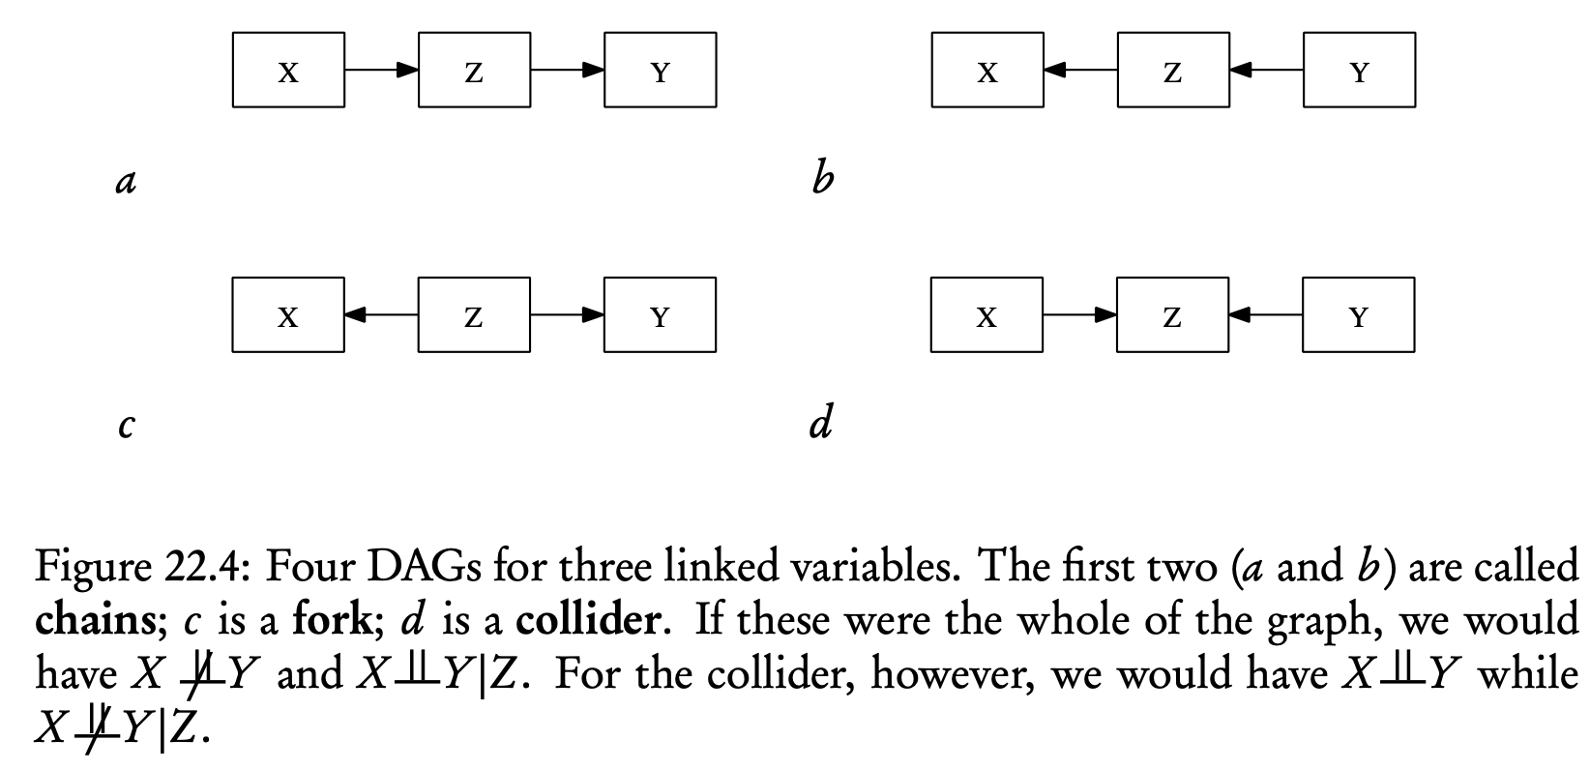
5. Causality
x
w_{c}
Structural casual model (SCM)^{[SCM95]}
Conditional Independence and d-Separation

Slide 21
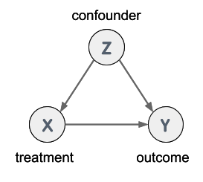
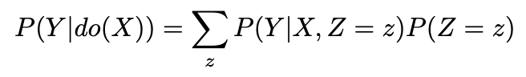
5. Causality
x
w_{c}
back-door criterion^{[SCM95]}
Intervention the treatment to find out its causal effect on outcome.
Based on deconfounder method, we can do casual inference on monitoring dataset instead to do Random Selection Experiment.

Slide 22
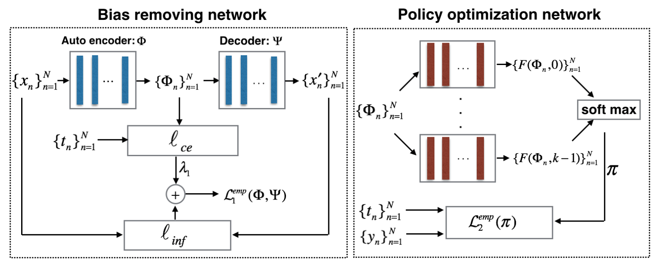
5. Causality
x
w_{c}
Deconfounder^{[Deconfounder19]}

Slide 23
Reference
[Deconfounder19] O.Atan,J.Jordon,andM.v.d.Schaar.Deep-Treat-LearningOptimalPersonalizedTreatments from Observational Data using Neural Networks. Association for the Advancement of Artificial Intelligence, 2018.
[LRP15] S. Bach, A. Binder, G. Montavon, F. Klauschen, K.-R. Müller, and W. Samek. On Pixel- Wise Explanations for Non-Linear Classifier Decisions by Layer-Wise Relevance Propagation. PLOS ONE, 10:e0130140, 2015.
[VI16] D. M. Blei, A. Kucukelbir, and J. D. McAuliffe. Variational Inference: A Review for Statisticians. Journal of the American Statistical Association, 112:859–877, 2016.
[SLDA10] D. M. Blei and J. D. McAuliffe. Supervised Topic Models. 2010.
[LDA03] D. M. Blei, A. Y. Ng, and M. I. Jordan. Latent Dirichlet Allocation. Journal of Machine Learning Research, 3:993–1022, 2003.
[AM09] D. Erhan, Y. Bengio, A. Courville, and P. Vincent. Visualizing Higher-Layer Features of aDeep Network.University of Montreal, 2009
[CDBN09] H. Lee, R. Grosse, R. Ranganath, and A. Y. Ng. Convolutional deep belief networks for scalable unsupervised learning of hierarchical representations. pages 609–616, 2009.
[XNLP15] J. Li, X. Chen, E. Hovy, and D. Jurafsky. Visualizing and Understanding Neural Models in NLP. 2015.
[XNN18] Z. C. Lipton. The mythos of model interpretability. Communications of the ACM, 61:36–43, 2018.
[Taylor17] G. Montavon, S. Lapuschkin, A. Binder, W. Samek, and K.-R. Müller. Explaining nonlinear classification decisions with deep Taylor decomposition. Pattern Recognition, 65:211–222, 2017.
[Montavon18] G. Montavon, W. Samek, and K.-R. Müller. Methods for interpreting and understanding deep neural networks. Digital Signal Processing, 73:1–15, 2018.
[AMGAN17] A. Nguyen, J. Clune, Y. Bengio, A. Dosovitskiy, and J. Yosinski. Plug & Play Generative Networks: Conditional Iterative Generation of Images in Latent Space. 2017 IEEE Conference on Computer Vision and Pattern Recognition (CVPR), pages 3510–3520, 2017.
[GAN16] A. Nguyen, A. Dosovitskiy, J. Yosinski, T. Brox, and J. Clune. Synthesizing the preferred inputs for neurons in neural networks via deep generator networks. 2016.
[AMRP16] A. Nguyen, J. Yosinski, and J. Clune. Multifaceted Feature Visualization: Uncovering the Different Types of Features Learned By Each Neuron in Deep Neural Networks. 2016.
[14] A. v. d. Oord, N. Kalchbrenner, and K. Kavukcuoglu. Pixel Recurrent Neural Networks. 2016.
[SCM95] J. PEARL. Causal diagrams for empirical research. Biometrika, 82:669–688, 1995.
[XNN16] M. T. Ribeiro, S. Singh, and C. Guestrin. Why Should I Trust You?: Explaining the Predictions of Any Classifier. pages 1135–1144, 2016.
[FCN16] E. Shelhamer, J. Long, and T. Darrell. Fully Convolutional Networks for Semantic Segmenta- tion. 2016.
[DICN13] K.Simonyan,A.Vedaldi,andA.Zisserman.Deep Inside Convolutional Networks:Visualising Image Classification Models and Saliency Maps. 2013.
[AllCNN14] J. T. Springenberg, A. Dosovitskiy, T. Brox, and M. Riedmiller. Striving for Simplicity: The All Convolutional Net. 2014.

Slide 24
6. Conclusion
x
w_{c}
是否存在一种具备因果推理或贝叶斯推理的标准网络模型？
并行可扩展性；
编码空间的可解释性；
编码空间的物理一致性；
Reference download URL: https://cloud.tsinghua.edu.cn/d/bf8a63c2f2bf407a8c23/

Slide 25

联系方式
13911132361
liheng19@mails.Tsinghua.edu.cn
Reference download URL: https://cloud.tsinghua.edu.cn/d/bf8a63c2f2bf407a8c23/

